Slide 1

RDBMS MINI PROJECT
EXAMINATION AND EVALUATION SYSTEM
Presented by
Team - 5
Notes:
O Logo de espadas deve ter mais espaço das pontas abaixo. Sugerir outros tipos de imagens/ telefone, fones.

Slide 2
TEAM – 5 TEAM MEMBERS
BHAVANA CHIPPE - 146692
SPOORTHY SANKURU - 147084
SWETHA GONDI - 146787
RAJASEKHAR AADULA - 147081
SANDEEP PERNAPATI - 146980

Slide 3
TABLE OF CONTENTS
EVOLUTION OF DATABASE
INTRODUCTION TO SQL
INTRODUCTION TO PL/SQL
OBJECTIVE
ABSTRACT
SOFTWARE REQUIREMENTS
REQUIREMENTS
FULLFILLING REQUIREMENTS
TABLES USED
UML DIAGRAMS
ER DIAGRAM

Slide 4
SOFTWARE ARCHITECTURE
SQL STATEMENT PROCESSING PHASES
SQL QUERIES PARSING
TOPICS USED FOR CODING
SOFTWARE ENGINEERING
SQL
PLSQL
TEST CASES
REAL TIME IMPLEMENTATION
ADVANTAGES
PEER TO PEER REVIEW
SUMMARY

Slide 5
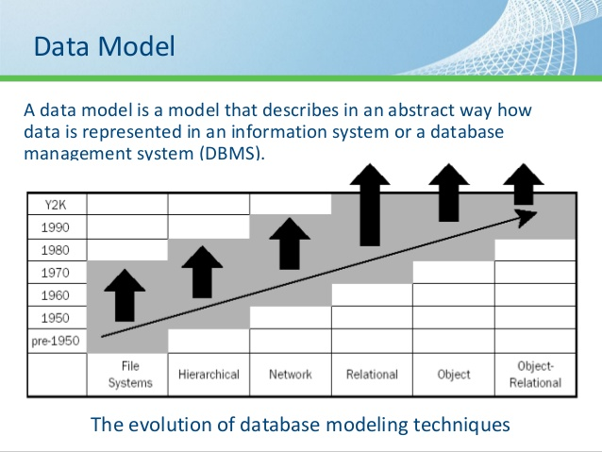
EVOLUTION OF DATABASE
The database evolution happened in four “waves”: • The first wave consisted of network, hierarchical, inverted list, and (in the 1990’s) object-oriented DBMSs; it took place from roughly 1960 to 1999. • The relational wave introduced all of the SQL products (and a few non-SQL) around 1990 and began to lose users around 2008. • The decision support wave introduced Online Analytical Processing (OLAP) and specialized DBMSs around 1990, and is still in full force today. • The NoSQL wave includes big data, graphs, and much more; it began in 2008.

Slide 6
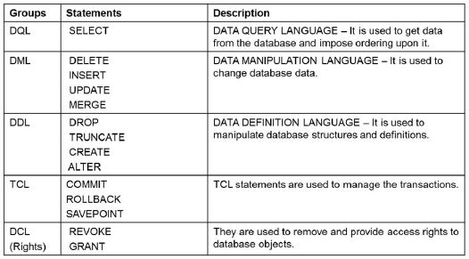
INTRODUCTION TO SQL
SQL stands for Structured Query Language.
Pronounced as SEQUEL, SQL was originally developed by IBM based on Dr. E.F. Codd’s relational model.
It was developed to define, manipulate and control data in a database.
The main operations performed are DQL,
DML,DDL,TCL,DCL.

Slide 7
INTRODUCTION TO PL/SQL
PL SQL is an extension of SQL language, designed for seamless processing of SQL statements enhancing the security, portability, and robustness of the database.
With PL/SQL, you can use SQL statements to manipulate data and flow-of control statements to process the data.
Moreover, you can declare constants and variables, define procedures and functions, and trap runtime errors.
Thus PL/SQL combines the “data manipulating power” of SQL with the “data processing power” of procedural languages.

Slide 8
OBJECTIVE
Designing the database, developing the queries and basic reports required for Examination & Evaluation System.

Slide 9
ABSTRACT OF THE PROJECT
This database is used as Examination & Evaluation system for employees.
Also some basic reports have been developed.
Since this database is to be used by a front end systems, it also requires some backend query and procedure designing.

Slide 10
PLANNING PHASE
PLANNING METHODOLOGY :
team-5 project ppt\Mini Project Planning.xlsx

Slide 11
ANALYSIS PHASE
ANALYSIS STEPS :
team-5 project ppt\Mini Project Planning.xlsx

Slide 12
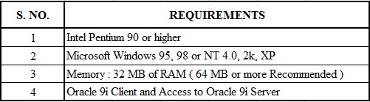
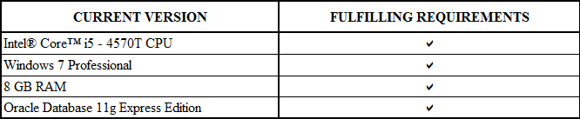
SOFTWARE REQUIREMENTS

Slide 13
DESIGN PHASE

Slide 14
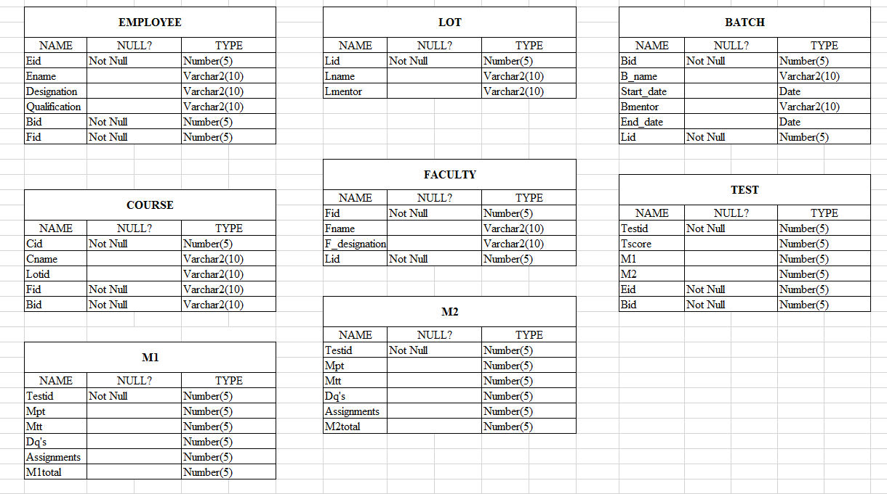
TABLES USED

Slide 15
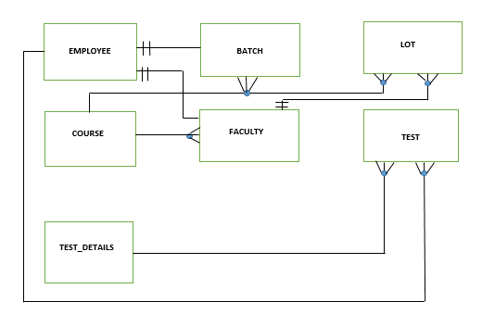
UML DIAGRAM

Slide 16
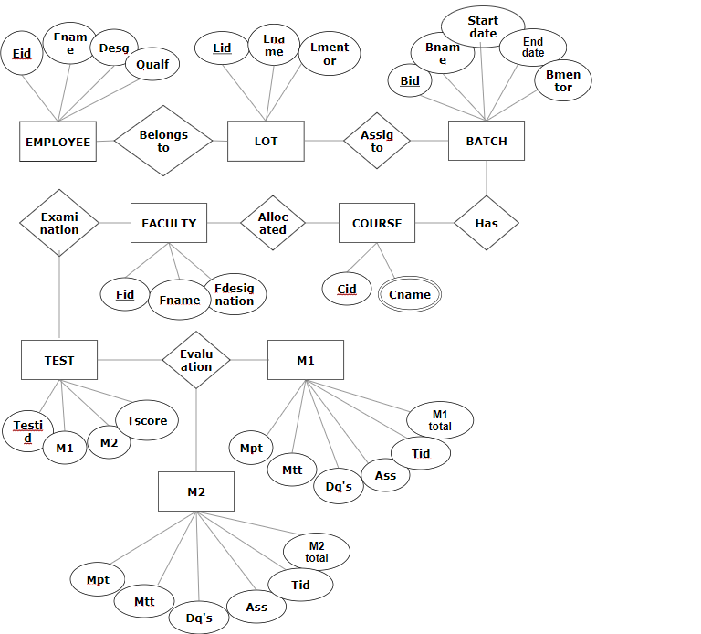
ER DIAGRAM

Slide 17
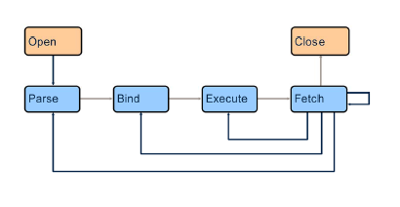
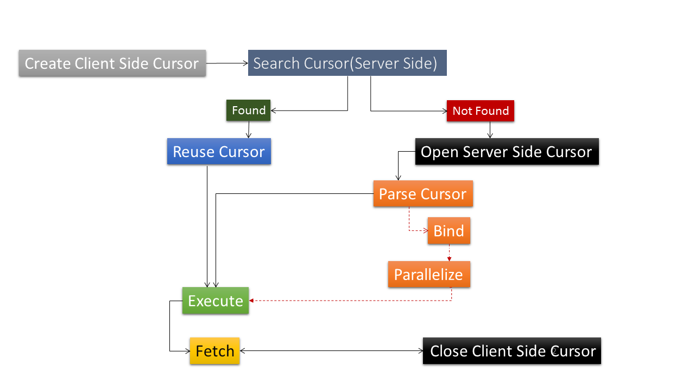
SOFTWARE ARCHITECTURE
SQL STATEMENT PROCESSING PHASES
SQL QUERIES PARSING

Slide 18
DEVELOPMENT PHASE

Slide 19
TOPICS USED FOR CODING
S. NO. | SUBJECT | TOPIC NAME
1 | SE |  | Data Model like Waterfall Model etc.,
2 | SQL |  | DDL, DML, DCL, TCL, DQL
3 | SQL |  | Joins & Sub Queries
4 | SQL |  | External Tables
5 | PLSQL |  | Procedures & Functions
6 | PLSQL |  | Triggers
7 | PLSQL |  | Exception Handling
8 | PLSQL |  | Cursors

Slide 20
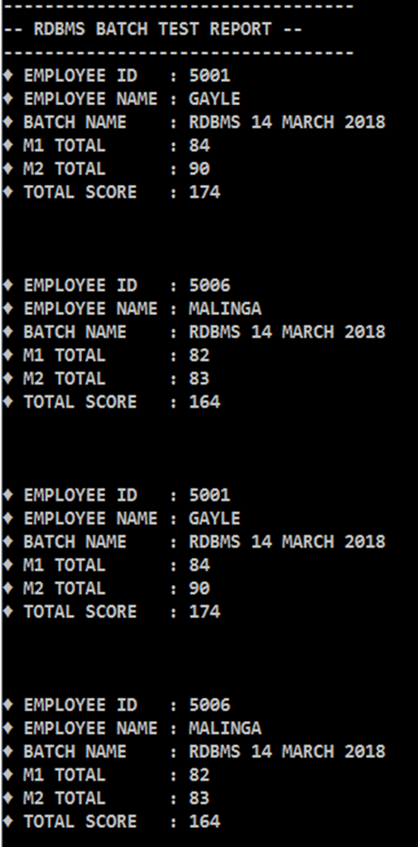
DEVELOPMENT PHASE
CODING:
To perform any functionalities or make applications run we use coding.
The process of designing, writing, testing, debugging / troubleshooting, and maintaining the source code of computer programs.
QUERY SNAPSHOTS:

Slide 21
TESTING PHASE

Slide 22
HOW TESTING IS PERFORMED?
BY EXAMINING THE USERS REQUIREMENTS
BY REVIEWING THE ARTIFACTS LIKE DESIGN DOCUMENTS
BY EXAMINING THE FUNCTIONALITY
BY EXAMINING THE INTERNAL STRUCTURES AND DESIGN
BY EXECUTING CODE

Slide 23
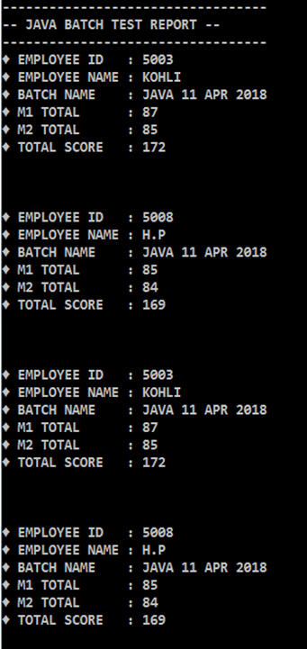
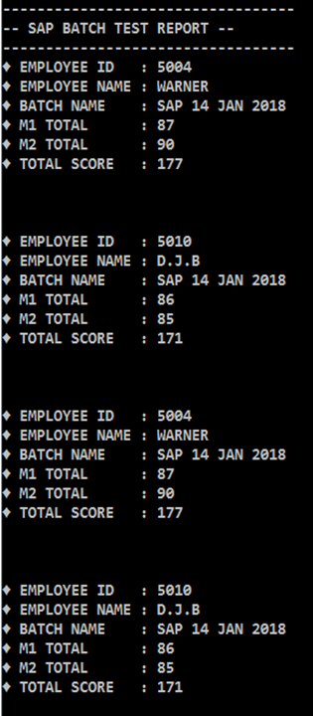
TEST CASES
Example :
Test report for all the employees batch wise.

Slide 24
TESTING SUMMARY
Tested in brief :-
We have tested the functionalities of data present in tables passing various input parameters.
Test Cases :-
Minimum Test cases Performed= 3
Total No. of test cases passed = 2
Total No. of Test cases passed giving exceptions =1
People Worked :-
No. of People worked in this project = 5.

Slide 25
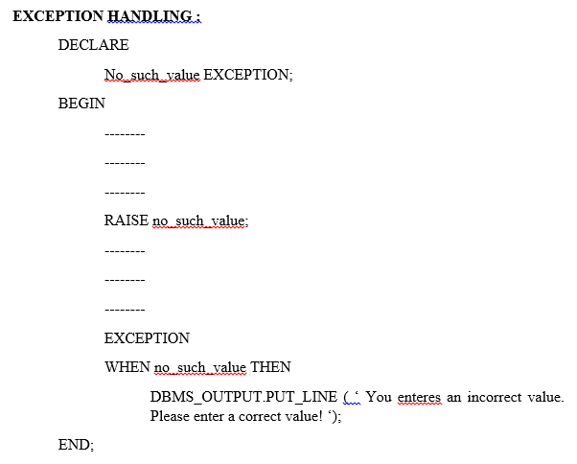
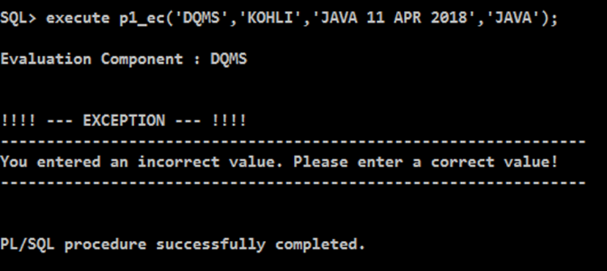
EXCEPTION HANDLING

Slide 26
REAL TIME IMPLEMENTATION
EMPLOYEE PERFORMANCE RECORD
EASY IMPLEMENTATION OF DATA USING PLSQL
ORAGNIZATIONS- EDUCATIONAL SYSTEMS
STORING OF EMPLOYEE PERFORMANCES
EVALUATION SCHEME

Slide 27
ADVANTAGES
REDUCES NETWORK TRAFFIC
ERROR HANDLING
IMPROVES APPLICATION PERFORMANCE

Slide 28
REVIEW SHEET
DESCRIPTION | YES | NO
Is the code well-structured, consistent in style, and consistently formatted?
Are there any uncalled or unneeded modules or any unreachable code?
Is the code clearly and adequately documented with an easy-to-maintain commenting style?
Are all variables properly defined with meaningful, consistent, and clear names?
Are there any redundant or unused variables?
Are all loops, branches, and logic constructs complete, correct, and properly nested?
Are files / variables checked for existence before attempting to access them?

Slide 29
SUMMARY
A DATABASE SYSTEM FOR EXAMINATION AND EVALUATION SYSTEM IS BUILD WITH NECESSARY FUNCTIONALITIES.
VARIOUS FUNCTIONALITIES WHICH ARE BUILD USING THIS PROJECT IS :
CREATING TABLES
INSERTING DATA
DISPLAYS TEST MARKS OF AN EMPLOYEE WITH GIVEN SPECIFICATIONS
GIVES DETAILS OF BATCHES
PROCEDURES TO ACCEPT DETAILS AND DISPLAY REQUIRED FUNCTIONALITIES
CALCULATES ASSESMENT DETAILS
TRIGGERS TO CHECK THE REQUIREMENTS
CREATING DATA REPORTS

Slide 30
IMPORTANT LINKS
team-5 project ppt\Mini Project Planning.xlsx
team-5 project ppt\miniproject_scriptfile main.txt
team-5 project ppt\Queries.docx

Slide 31
THANK YOU

